Slide 1


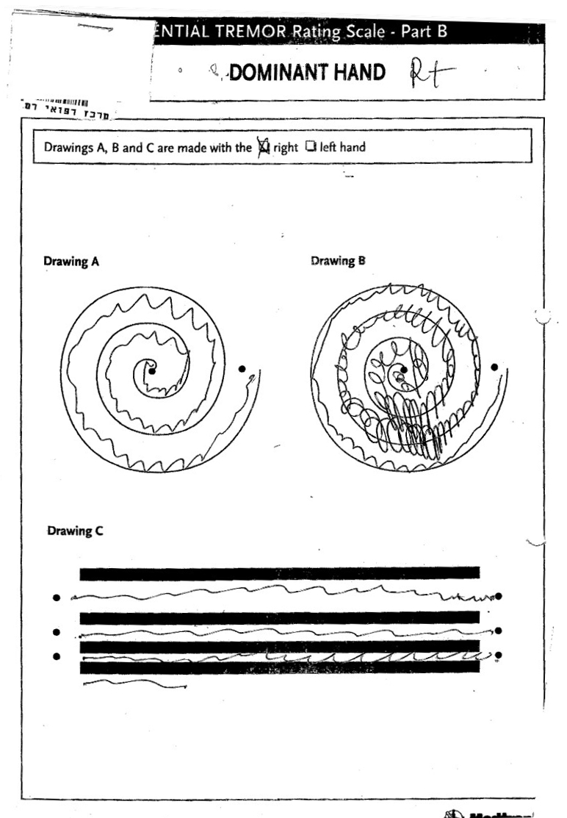
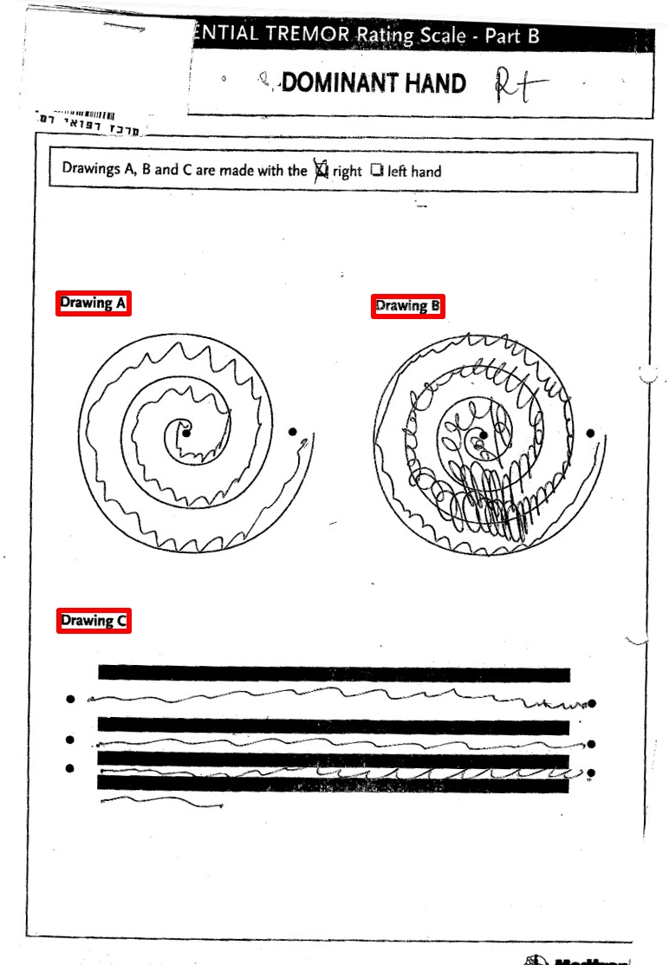
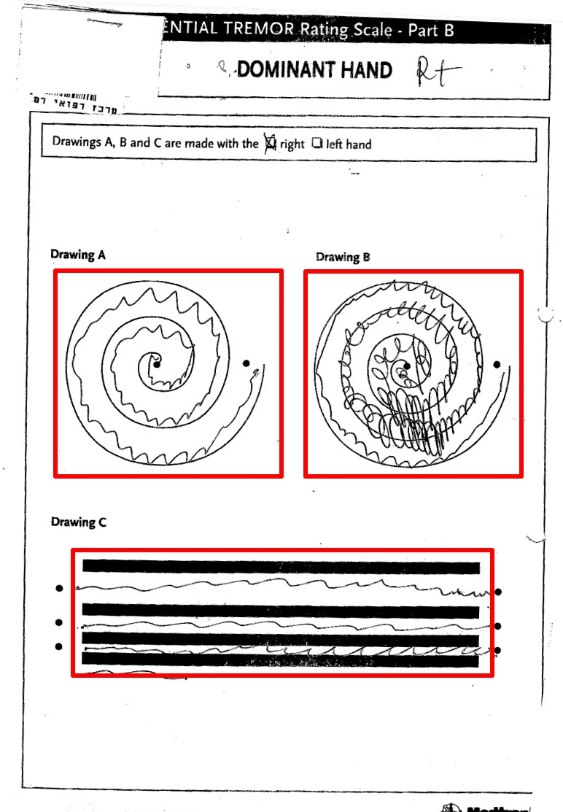
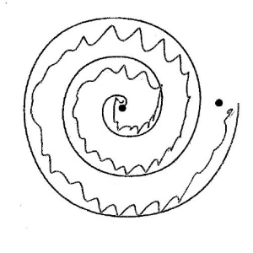
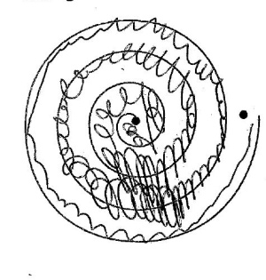
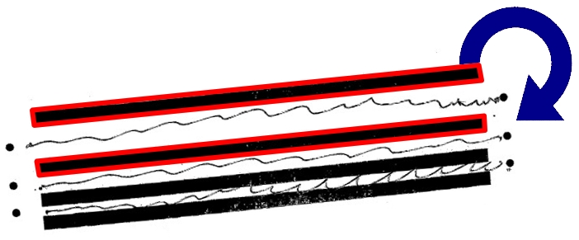
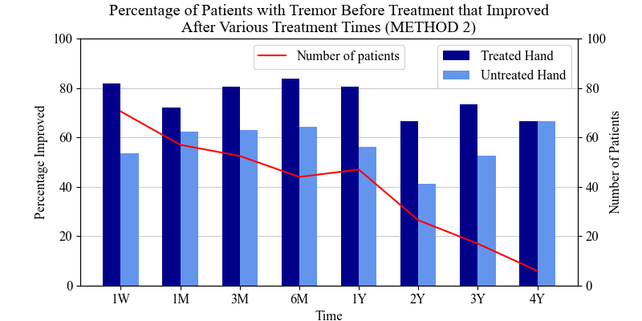
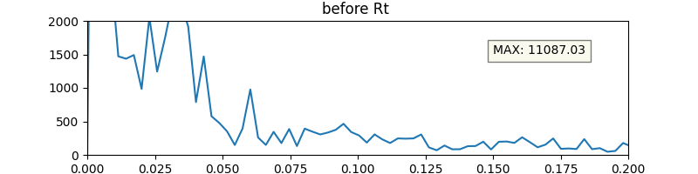
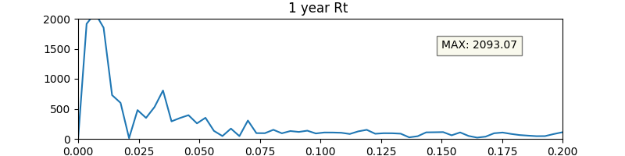
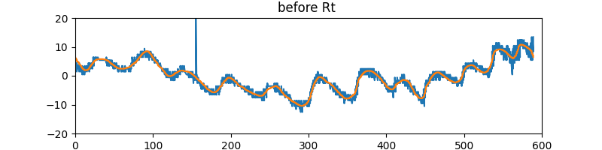
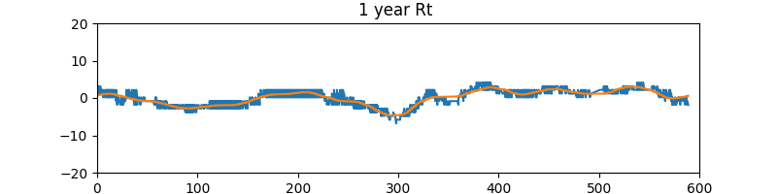
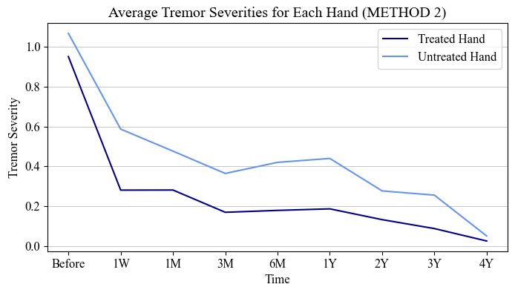
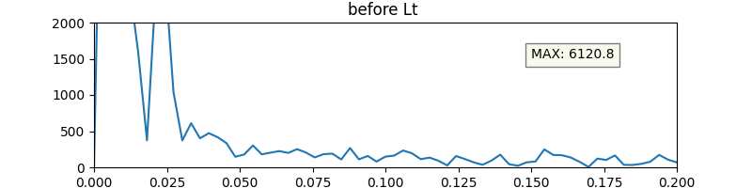
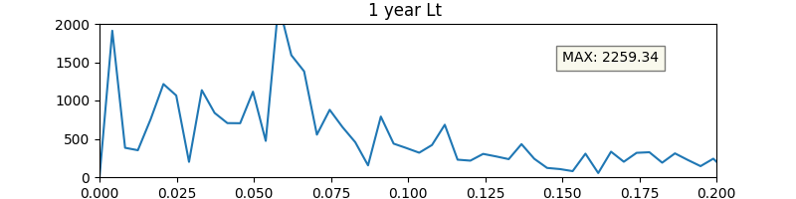
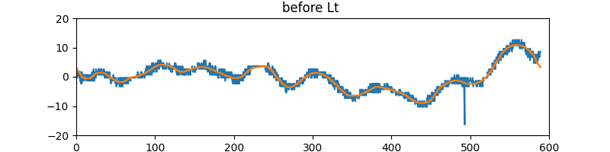
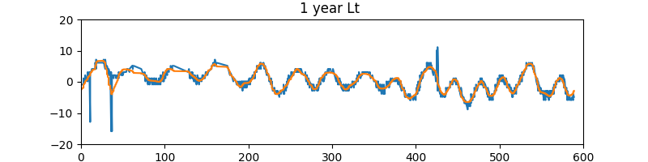
BACKGROUND
Focused Ultrasound Treatment (FUS) is a promising treatment for movement disorders such as Essential Tremor (ET) and Parkinson’s Disease (PD). FUS is a new treatment technique that has proven to have a therapeutic effect on brain disorders. FUS is a non-invasive treatment that functions by delivering sound waves to the patient’s thalamus, the part of the brain responsible for relaying sensory and motor signals, resulting in the formation of a permanent lesion in this region of the brain [3][4]. This lesion interrupts abnormal brain activity, reducing uncontrollable movements associated with ET and PD. FUS is only performed on one side of the brain, thus it only improves the movement on one side of the body. This treatment has been seen to result in immediate reduction in tremor in the side of the body receiving treatment.
This study will focus on FUS as a treatment for patients with ET and PD in an attempt to determine whether the treatment is successful in reducing tremor, slowing the progression of these conditions.
Aim
Quantitatively investigate the efficacy of the FUS treatment by investigating computational and statistical analysis of spiral drawings. Provide insight about the extent that these results can be used to assess the severity of tremor on the patient’s treated or untreated side after the treatment.
Which Hand? – 22PO5
Robyn Gebbie and Jesse van der Merwe
DATA
The Rambam Medical Centre, Haifa Israel, has provided data that comprises of 122 fully anonymised hand drawn shapes on paper that patients and drew over time of treatment with both their treated and untreated hand. Out of the 122 patients, 34 are undergoing treatment for Parkinson’s Disease, and the remaining 88 for Essential Tremor, however, it was decided to group all patients together as the aim of this project does not differentiate between disease/disorder, but only on success of treatment.
Data Pre-processing
Data Analysis
Each patient completes multiple template drawings with both hands at various time intervals before and after receiving treatment. These physical drawings are scanned and saved as a PDF.
Some scans are pixelated, rotated or contain erroneous markings.
Each scan is converted to JPE format using Pdf2Image convert_from_path( ).
Basic Cropping
OpenCV EAST Text Detection [6] detects the corner coordinates of the “Drawing A”, “Drawing B” and “Drawing C” text on each image.
The relative position of spiral A, spiral B, and line-block C is determined using the best available combination of the text coordinates.
Each new image is cropped and resized to ensure consistent pixel distribution for better comparison further.
Further Correction
In order to remove any erroneous markings and save only the template and hand-drawn markings, each cropped image is converted to greyscale. Then all dark pixels are converted to black and all light pixels to white.
OpenCV is used to identify the solid black rectangles in the line-block images [7] to correct any rotation or perspective warp [8]. Only the top most line is saved.
Final Clean-up
A high rate of acceptably cropped and corrected images was produced. Erroneous results did occur due to poor quality inputted scans. These were manually removed or corrected if possible.
DISCUSSION AND RESULTS
Discussion
Stuff and Stuff
Results
Stuff and Stuff
METHOD 2
TABLE 2: | Treated Hand BEFORE | Treated Hand 1 YEAR
Original drawing RFFT IIR bandpass filter Result | 12 peaks * 5.81 avg. peak adjacent distance = 69.67 tremor severity | 7 peaks * 2.43 avg. peak adjacent distance = 17.02 tremor severity
METHOD 2: LINE DRAWING TREMOR QUANTIFICATION
Extracting the Hand-Drawn Line
The line image is inputted using the cv2 imread( ) function. NumPy argwhere( ) function extracts the x- and y-coordinates of every pixel that is not white. These pixels are stored in arrays sorted according to the x-axis. Each y-value is shifted by the average y-value to centre the line around the horizontal axis.
Noise Reduction
Since all y-values are real, the faster SciPy rfft( ) function is used to compute the one-dimensional Fourier Transform. It can be seen that there is a very small range of useful frequencies. The higher unwanted frequencies – caused by pixelated/blurry input or erroneous markings on the original drawing – are discarded.
The SciPy irfft( ) function is used to return the inverse discrete Fourier transform once again. The data is now noise free and the Signal find_peaks( ) function is used to find all maximum (peak) and minimum (trough) points in order to count the number of tremors as well as the distance between each adjacent peak and trough.
Determining a Tremor Severity Measure
The number of peaks in the function is an indication of the frequency of the patient’s tremors. In general, more peaks indicates a worse tremor.
The distance between each adjacent tremor’s peaks and troughs indicate the severity of the tremor. A larger distance only indicates a worse tremor when occurring with a high number of peaks. A large distance with a very low number of peaks could be an indication of a line image that has been incorrectly cropped (slanted).
Since these two variables are proportionally linked to the severity of a tremor, the product of the two variables is used as an indication of tremor severity.
TABLE 3: | Untreated Hand BEFORE | Untreated Hand 1 YEAR
Original drawing RFFT IIR bandpass filter Result | 8 peaks * 4.95 avg. peak adjacent distance = 39.58 tremor severity | 16 peaks * 6.18 avg. peak adjacent distance = 98.81 tremor severity
References
[1] | M. Rohani and A. Fasano, "Focused Ultrasound for Essential Tremor: Review of the Evidence and Discussion of Current Hurdles.," Tremor and Other Hyperkinet Movements (NY), vol. 462, no. 7, 2017.
[2] | C. A. Davie, "A review of Parkinson's disease," British Medical Bulletin, no. 86, pp. 109-127, 2008.
[3] | H. Baek, D. Lockwood, E. J. Mason, E. Obusez, M. Poturalski, R. Rammo, S. J. Nagel and S. E. Jones, "Clinical Intervention Using Focused Ultrasound (FUS) Stimulation of the Brain in Diverse Neurological Disorders," Frontiers in Neurology, vol. 13, 2022.
[4] | A. Rosebrock, "OpenCV Text Detection (EAST text detector) - PyImageSearch," PyImageSearch, 20 August 2018. [Online]. Available: https://pyimagesearch.com/2018/08/20/opencv-text-detection-east-text-detector/. [Accessed 16 July 2022].
[5] | A. Rosebrock, "OpenCV shape detection - PyImageSearch," PyImageSearch, 8 February 2016. [Online]. Available: https://pyimagesearch.com/2016/02/08/opencv-shape-detection/. [Accessed 20 July 2022].
[6] | jdhao, "Cropping Rotated Rectangles from Image with OpenCV," jdhao's digital space, 23 February 2019. [Online]. Available: https://jdhao.github.io/2019/02/23/crop_rotated_rectangle_opencv/. [Accessed 26 July 2022].

Slide 2
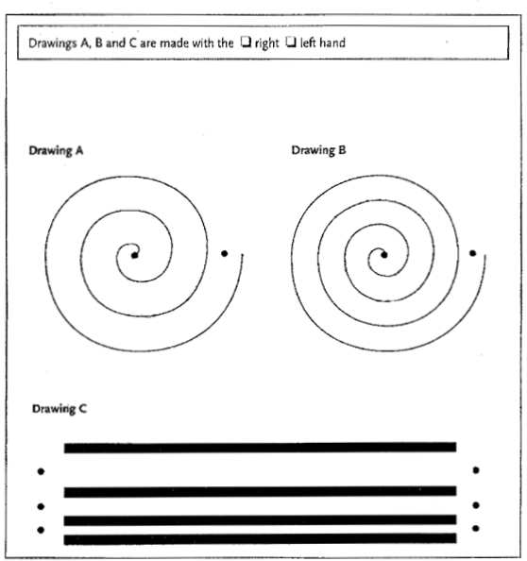
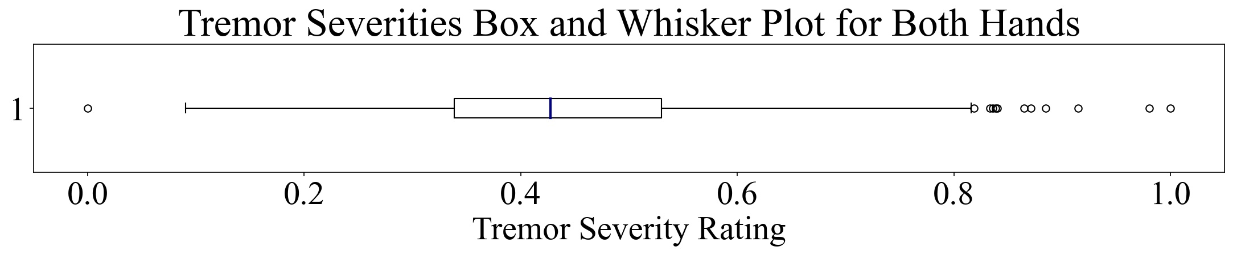
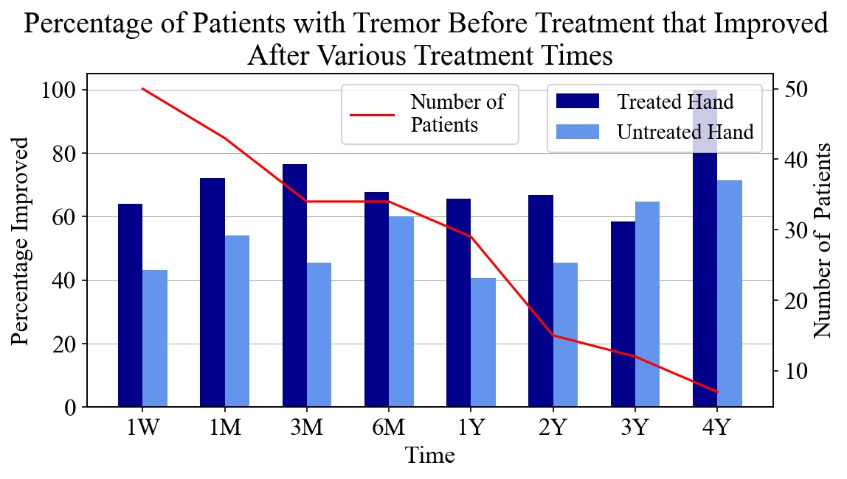
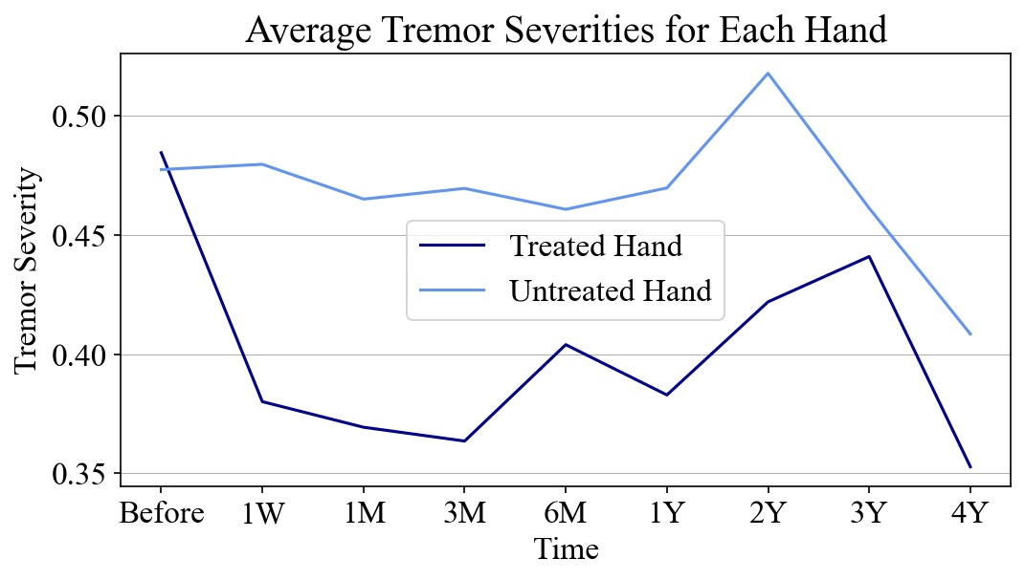
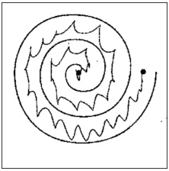
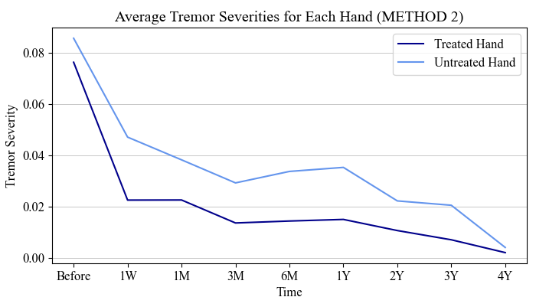
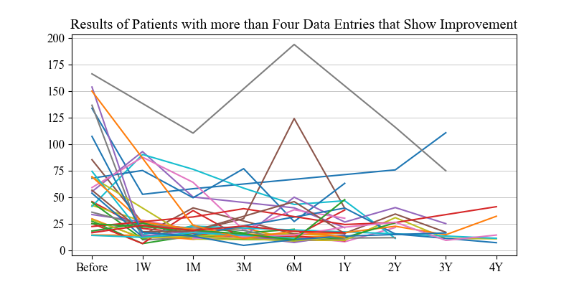
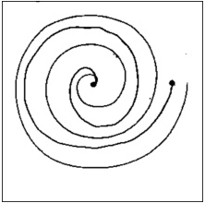
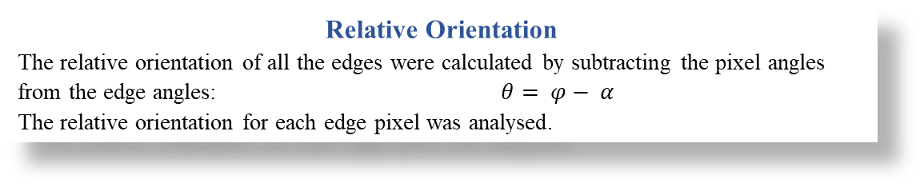
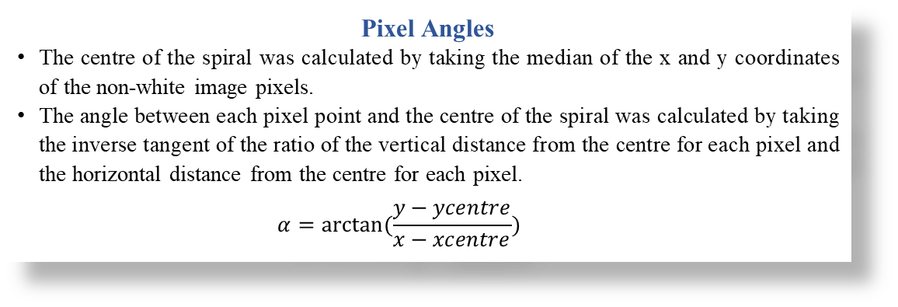
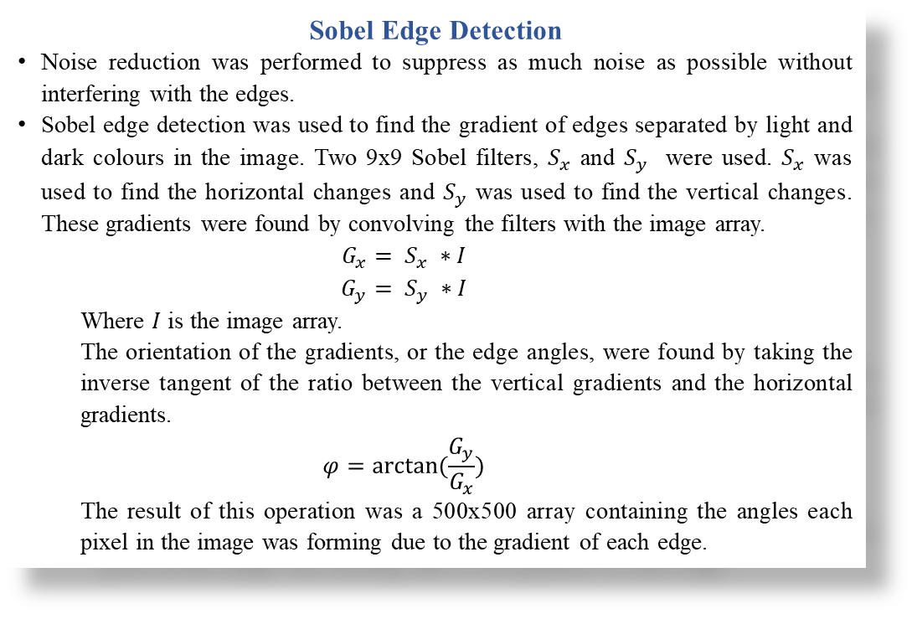
Background
Focused Ultrasound Treatment (FUS) is a promising treatment for movement disorders such as Essential Tremor and Parkinson’s Disease. FUS is a new treatment technique that has been proven to have a therapeutic effect on brain disorders. FUS is a non-invasive treatment that functions by delivering sound waves to the patient’s thalamus, the part of the brain responsible for relaying sensory and motor signals, resulting in the formation of a permanent lesion in this region of the brain [3][4]. This lesion acts to interrupt abnormal brain activity, reducing uncontrollable movements associated with Essential Tremor and Parkinson’s Disease. FUS is only performed on one side of the brain, thus it only improves the movement on one side of the body. This treatment has been seen to result in immediate reduction in tremor in the side of the body receiving treatment.
This study will focus on FUS as a treatment for patients with Essential Tremor and Parkinson’s Disease in an attempt to determine whether the treatment is successful in reducing tremor, slowing the progression of these conditions. The Rambam Medical Centre, Haifa Israel, has provided data that comprises of 122 fully anonymised hand drawn shapes on paper that patients and drew over time of treatment with both their treated and untreated hand [5]. Out of the 122 patients, 34 are undergoing treatment for Parkinson’s Disease, and the remaining 88 for Essential Tremor, however, it was decided to group all patients together as the aim of this project does not differentiate between disease/disorder, but only on success of treatment.
Which Hand?
Robyn Gebbie and Jesse van der Merwe
PRE-PROCESSING STEP 1: Data Analysis for the Chosen Methods
In this investigation, two distinct methods are focused on: method 1 will focus on the spiral drawing found in “Drawing A” and method 2 will focus on the line drawing found in “Drawing C”, as seen on the template that each patient has to fill in at various time intervals before and after receiving treatment to one hand. Most, but not all, patients received treatment to their dominant hand. Out of the 122 patients, 34 are undergoing treatment for Parkinson’s Disease, and the remaining 88 for Essential Tremor, however, it was decided to group all patients together as the aim of this project does not differentiate between disease/disorder, but only on success of treatment.
Aim
Quantitatively investigate the efficacy of the FUS treatment by investigating computational and statistical analysis of spiral drawings. Provide insight about the extent that these results can be used to assess the severity of tremor on the patient’s treated or untreated side after the treatment.
Template
PRE-PROCESSING STEP 2: Basic Cropping
Since each of the patient’s scanned drawings are based on the same template, OpenCV Text Detection (EAST text detector) [6] can be used to determine the coordinates of “Drawing A”, “Drawing B” and “Drawing C” text’s four corners. If found, this produces sets of coordinates for each image. Using the best available combination of the three required sets, the relative position of both spirals and the lines can be accurately determined in order to crop and save each as a new image, which is resized to ensure consistent pixel distribution for better comparison further.
PRE-PROCESSING STEP 3: Further Correction
In order to reduce error due to blurry or erroneous markings on the scanned drawings, each newly cropped image is converted to greyscale and any pixels that are light in colour are removed. This leaves only the pixels of the template and the hand-drawn markings.
The rotation of the lines is critical and changes the accuracy of the results drastically. Thus, the line image undergoes further pre-processing by using OpenCV to identify the solid black rectangles in the image [7] in order to correct any rotation or perspective warp [8] that occurs due to human inconsistencies when scanning in the patient’s drawings. While this process successfully identifies all three of the hand-drawn lines, it was decided to only use the top (and biggest) line as it was more accurately cropped and corrected compared to the other lines.
METHOD 1: Spiral Drawing Tremor Quantification
Analysis of Edge Angles in Spiral
The severity of the spiral drawings was assessed using edge detection to determine the gradient of every pixel in the spiral. This gradient was used to find the orientation of each edge in the spiral relative to the centre of the spiral. The relative orientation of each edge provided the means to determine the distribution of edge angles throughout the drawing, providing insight on the tremor severity of the hand drawn spiral.
Sobel Edge Detection
Noise reduction was performed to suppress as much noise as possible without interfering with the edges.
Sobel edge detection was used to find the gradient of edges separated by light and dark colours in the image. Two 9x9 Sobel filters, $S_{x}$ and $S_{y}$ were used. $S_{x}$ was used to find the horizontal changes and $S_{y}$ was used to find the vertical changes. These gradients were found by convolving the filters with the image array.
$$G_{x}= S_{x} ∗I$$
$$G_{y}= S_{y} ∗I$$
Where $I$ is the image array.
The orientation of the gradients, or the edge angles, were found by taking the inverse tangent of the ratio between the vertical gradients and the horizontal gradients.
$$φ=arctan⁡(\frac{G_{y}}{G_{x}})$$
The result of this operation was a 500x500 array containing the angles each pixel in the image was forming due to the gradient of each edge.
METHOD 2: Line Drawing Tremor Quantification
PRE-PROCESSING STEP 4: Final Clean-up
This pre-processing method produces a high rate of acceptably cropped and corrected images, however, it is limited to the quality of the inputted hand-drawn image. Ideally, further code would be researched, developed and implemented in order to identify the incorrectly cropped images, however this is outside the scope of this project. It was therefore necessary to manually check the produced images and remove/correct any that were unsuccessfully cropped due to blurry, blank or inconsistent input images.
Extracting the Hand-Drawn Line
The line image is inputted using the cv2 imread( ) function. NumPy argwhere( ) function could is then used to extract the x and y coordinates of every pixel that is not white. These pixels are stored in arrays sorted according to the x-axis. Each y-value is shifted by the average y-value to centre the line around the horizontal axis.
Pixel Angles
The centre of the spiral was calculated by taking the median of the x and y coordinates of the non-white image pixels.
The angle between each pixel point and the centre of the spiral was calculated by taking the inverse tangent of the ratio of the vertical distance from the centre for each pixel and the horizontal distance from the centre for each pixel.
$$α=arctan⁡(\frac{y−ycentre}{x−xcentre})$$
Noise Reduction
Since all y-values are real, the SciPy rfft( ) function is used (instead of the slower fft( ) function) to compute the one-dimensional Fourier Transform. It can be seen that there is a very small range of useful frequencies – the higher unwanted frequencies are discarded. These unwanted frequencies are caused by pixelated/blurry input or erroneous markings on the original drawing.
The SciPy irfft( ) function is used to return the inverse discrete Fourier transform once again. The data is now noise free and the Signal find_peaks( ) function is used to find all maximum (peak) and minimum (trough) points in order to count the number of tremors as well as the distance between each adjacent peak and trough.
TABLE 2: | Treated Hand – BEFORE | Treated Hand – 1 YEAR
Original drawing RFFT IIR bandpass filter Result | 12 peaks * 5.81 avg. peak adjacent distance = 69.67 tremor severity | 7 peaks * 2.43 avg. peak adjacent distance = 17.02 tremor severity
Relative Orientation
The relative orientation of all the edges were calculated by subtracting the pixel angles from the edge angles: $θ= φ− α$
The relative orientation for each edge pixel was analysed.
Tremor Quantification
The distribution of the relative orientation angles was plotted in the form of a histogram to outline the distribution of edge angles. The main indication of high tremor is a high standard deviation. A more widely distributed histogram indicates that the edge angles in the spiral vary considerably. The standard deviations for each spiral for each patient were determined and normalised to form a dataset quantifying each spiral tremor for each patient.
Determining a Tremor Severity Measure
The number of peaks in the function is an indication of the frequency at which the patient’s hand tremors. In general, more peaks indicates a worse tremor. Further, the distance between each adjacent tremor’s peaks and troughs indicate the severity of the tremor. A larger distance generally only indicates a worse tremor when occurring with a high number of peaks. A large distance with a very low number of peaks could be an indication of a line image that has been incorrectly cropped (slanted). Since these two variables are proportionally linked to the severity of a tremor, it was decided to use the product of the two variables to reach the tremor severity measure for this method.
TABLE 3: | Untreated Hand – BEFORE | Untreated Hand – 1 YEAR
Original drawing RFFT IIR bandpass filter Result | 8 peaks * 4.95 avg. peak adjacent distance = 39.58 tremor severity | 16 peaks * 6.18 avg. peak adjacent distance = 98.81 tremor severity
Analysis of FUS Treatment
The tremor severity ratings calculated from the edge angle standard deviations were determined for each patient’s treated and untreated hands for each given treatment period.
The average of each severity was calculated and plotted for each treatment period and the percentage of patients whose tremor improved when compared to their tremor before treatment was determined.
It is important to note that the number of patients that went for treatment greatly decreases as time progresses which affects the reliability of the later years’ results.
Overall, the treatment appears to be successful, with an average of 71% of the treated hands seeing an immediate improvement in tremor severity after treatment and a clear immediate decrease in the average tremor severity after treatment begins.
DISCUSSION AND RESULTS
TABLE 1: Normalised Standard Deviations of Relative Orientations
Discussion
Discussion stuff
Results
Results stuff
 | Spiral A1 | Spiral A2
Normalised Standard Deviation | 0.63 | 0.19
Spiral A1
Spiral A2

